Slide 1
AUTOMATED HIERARCHICAL MANAGEMENT SYSTEM

Slide 2
OBJECTIVE
To check disinclination of employees in an organization.
Improved efficiency in management of organization.
User-System interaction with greater transparency.
Ensuring appropriate services for the user.

Slide 3
INTRODUCTION
This project aims at providing an automated management system for any hierarchical organization.
Service Oriented Architecture (SOA).

Slide 4
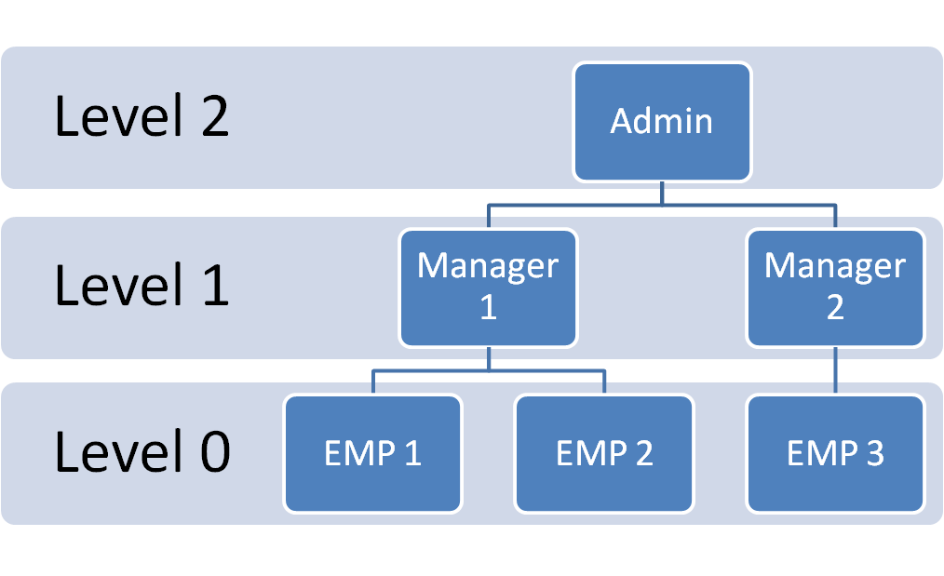
Process Model
SERVICE CLASSIFIER
USER

Slide 5
Internal Services
1. Certification.
2. Leave Messaging System (LMS).
3. Permissions.
4. Other Queries.

Slide 6
External Services
1. Employment.
2. Collaborations.
3. Internship.
4. Other Queries.

Slide 7
Requirements
Software requirements
Linux/Windows platform.
MySQL, PHP, Perl, HTML, .NET Framework.
Hardware requirements
Basic configured system.

Slide 8
Application
Can be implemented in any organization following hierarchical workflow.
e.g.: Government organizations,
Educational institutions,
IT organizations,
Banking Sector….

Slide 9
Advantages
Reduction in Transaction costs.
Automation, which leads to reduction in manual processing.
Paperless work.
Guaranteed service to the user.
No room for mismanagement.
Implementation of a friendly user interface.

Slide 10
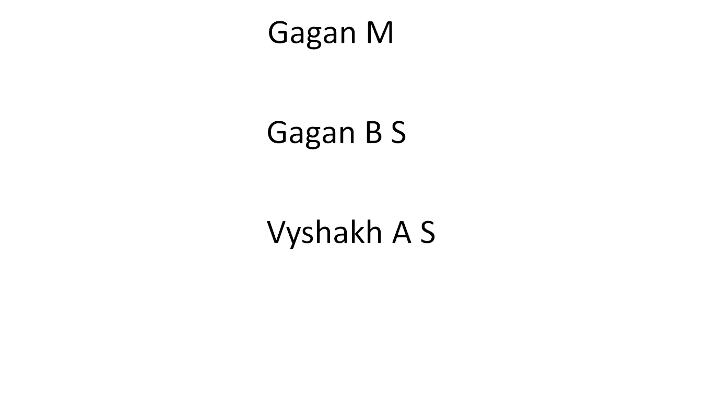
Team

